Slide 1


GBME Probability and Statistics
Lecture 02
Lecture 02
Data
CHOONG-WAN WOO | COCOAN lab | http://cocoanlab.github.io

Slide 2
Lecture 02
Statistics
“Statistics is about asking questions and using data to understand the answers.” (Tor D. Wager)
Professor, Psychology and Neuroscience, University of Colorado Boulder
My PhD and postdoc advisor
CHOONG-WAN WOO | COCOAN lab | http://cocoanlab.github.io

Slide 3
Lecture 02
Statistics
“Statistics is about asking questions and using data to understand the answers.” (Tor D. Wager)
“Statistics is the science of collecting, analyzing and interpreting data, or factual information.” (Martin A. Lindquist)
Professor, Biostatistics, Johns Hopkins University
Tor’s good friend and colleague, something like a co-advisor for me.
CHOONG-WAN WOO | COCOAN lab | http://cocoanlab.github.io

Slide 4
Lecture 02
Statistics
“Statistics is about asking questions and using data to understand the answers.” (Tor D. Wager)
“Statistics is the science of collecting, analyzing and interpreting data, or factual information.” (Martin A. Lindquist)
“Statistics is a way of reasoning, along with a collection of tools and methods, designed to help us understand the world.” (Textbook)
Statistics is becoming more and more important. Why??
CHOONG-WAN WOO | COCOAN lab | http://cocoanlab.github.io

Slide 5

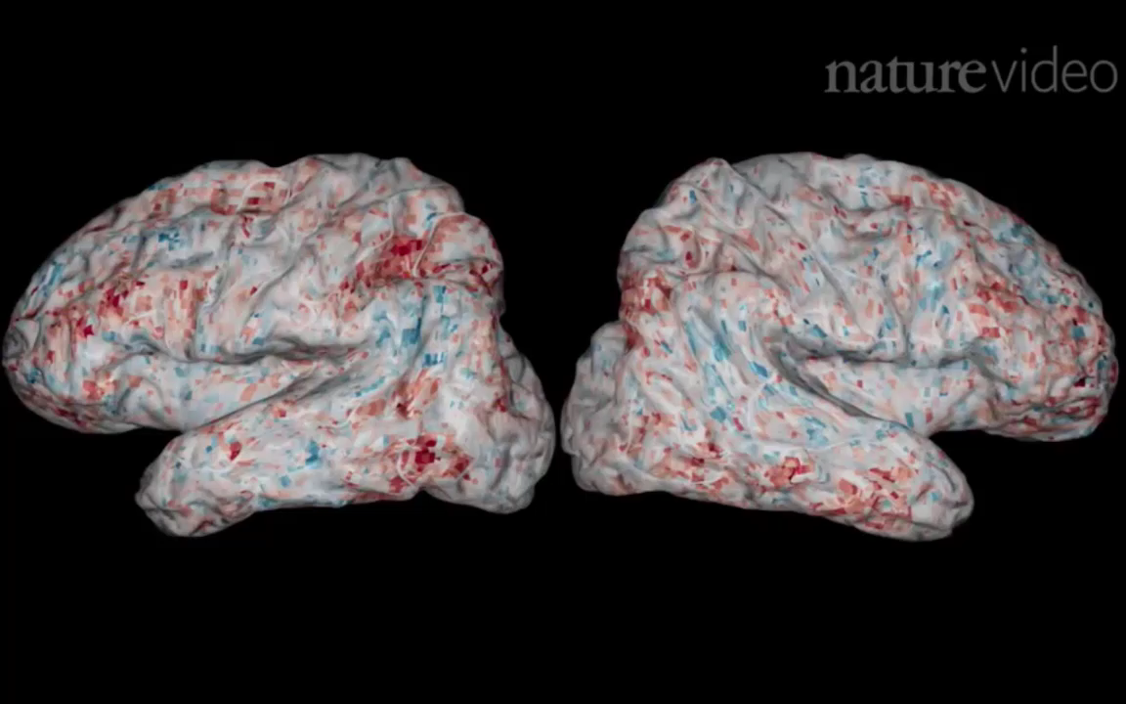
Lecture 02
Big data era!
Light-sheet microscopy: a larval zebrafish
Functional Magnetic Resonance Imaging
One-hour scan yields 1TB data.
fMRI: whole-brain scan in 460ms with 2 mm³ resolution
Videos from Freeman et al., 2014, Nat Methods; Huth et al., 2016, Nature
CHOONG-WAN WOO | COCOAN lab | http://cocoanlab.github.io

Slide 6
Lecture 02
Big data era! What’s the challenge?
Jeremy Freeman
Previously, Janelia Farm Research Campus
Currently, Chan-Zuckerberg Science Initiative
New technologies are now, finally, allowing us to probe
the activity of thousands of neurons simultaneously
while animals perform rich, ethologically relevant behaviors…
The first challenge to converting this newfound torrent of
neural measurement into fundamental scientific meaning is
to ask how to “make sense of the data.”
Statistics!!!
CHOONG-WAN WOO | COCOAN lab | http://cocoanlab.github.io

Slide 7
Lecture 02
Statistics
“Statistics is about asking questions and using data to understand the answers.” (Tor D. Wager)
“Statistics is the science of collecting, analyzing and interpreting data, or factual information.” (Martin A. Lindquist)
“Statistics is a way of reasoning, along with a collection of tools and methods, designed to help us understand the world.” (Textbook)
Statistics is a scientific way of searching for “meaning” out of data. (Choong-Wan Woo)
CHOONG-WAN WOO | COCOAN lab | http://cocoanlab.github.io

Slide 8
Lecture 02
Statistics
The problem is that people see only what they want to see! and statistics can serve as a lens to filter data!
From Martin’s stat class:
Three types of lies: Lies, damn lies and statistics.
Always approach statistics with a critical eye.
From Tor’s stat class:
“You can say anything with statistics”
Statistics don’t lie, but people can lie with statistics
CHOONG-WAN WOO | COCOAN lab | http://cocoanlab.github.io

Slide 9
Lecture 02
A statistician’s manifesto
(From T. Hastie, via J. McAuliffe, via Jordan Boyd-Graber)
Understand the ideas behind the statistical methods, so you know how to use them, when to use them, when not to use them.
Complicated methods build on simple methods. Understand simple methods first.
The results of a method are of little use without an assessment of how well or poorly it is doing.
CHOONG-WAN WOO | COCOAN lab | http://cocoanlab.github.io

Slide 10
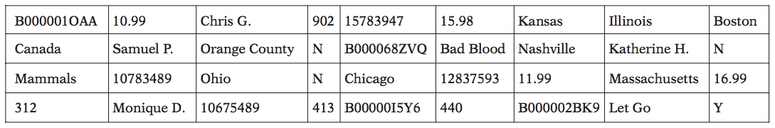
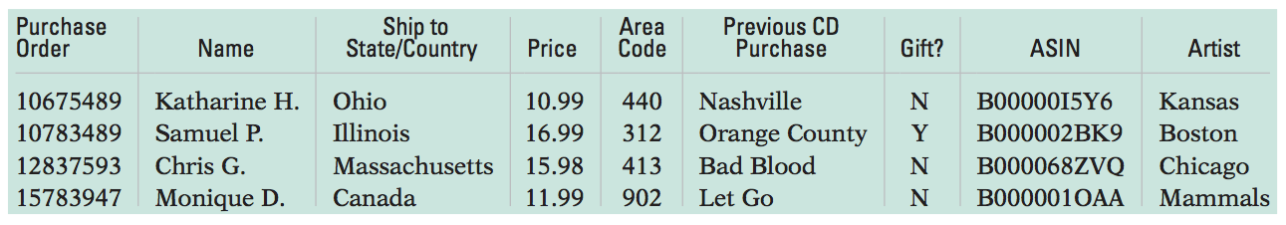
Lecture 02
Data
What is the problem?
No context: “We cannot make sense out of this table”
It is important to understand the context of your data set: ” 5W1H”
WHO, WHAT, WHEN, WHERE, WHY and HOW.
CHOONG-WAN WOO | COCOAN lab | http://cocoanlab.github.io

Slide 11
Lecture 02
Data
It is important to understand the context of your data set: ”5W1H”
WHO, WHAT, WHEN, WHERE, WHY and HOW.
We want to know who was measured, what was measured, how and where the data were collected and when and why the study was performed.
Always keep track of the unit of measurement.
CHOONG-WAN WOO | COCOAN lab | http://cocoanlab.github.io

Slide 12
Lecture 02
Data table
Variables are the characteristics observed/recorded about each observation.
Let’s make a data table using the data I collected last year:
Variables: →
(column)
→
→
→
→
Observations
(row)
 | sleep_hours_last_night | sleep_hours_average
Indiv 1 | 7 | 6
Indiv 2 | 5.5 | 6.5
Indiv 3 | 9 | 7
Indiv 4 | 5 | 7
Indiv 5 | 5 | 6
Indiv 6 | 7 | 8
Indiv 7 | 8 | 7
Indiv 8 | 7 | 8
Indiv 9 | 8 | 10
Indiv 10 | 10 | 9
Indiv 11 | 6 | 7.5
Indiv 12 | 7 | 9
Indiv 13 | 6 | 8
Indiv 14 | 5 | 8
Variables
(column)
→
→
→
→
Observations (row)
CHOONG-WAN WOO | COCOAN lab | http://cocoanlab.github.io

Slide 13
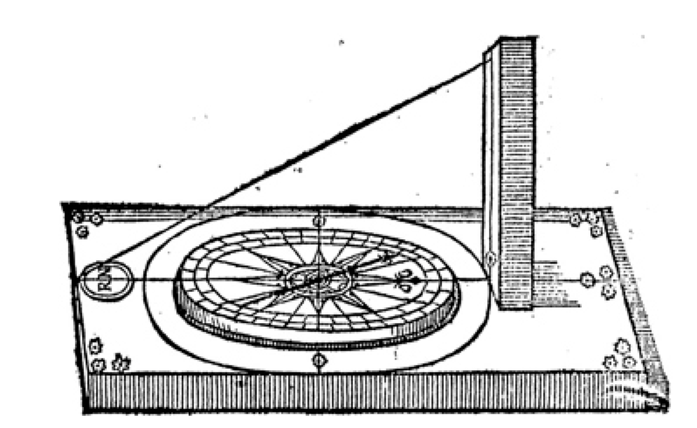
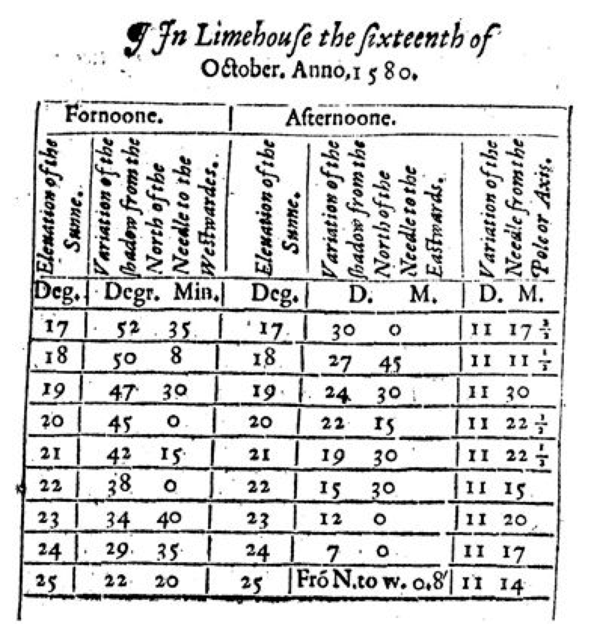
Lecture 02
Data table
It’s an old tradition.
Variables: →
(column)
→
→
→
→
Norman, 1581, “A Discours of the Variation of the Cumpas, or Magneticall Needle.”
Observations
(row)
CHOONG-WAN WOO | COCOAN lab | http://cocoanlab.github.io
From Stigler, “The Seven Pillars of Statistical Wisdom”

Slide 14
Lecture 02
Categorical and Quantitative variables
A categorical variable names groups or categories into which an individual case might fall.
E.g., Gender, hair color, car model.
A quantitative variable contains numerical values that are measured in units.
E.g., Height, age, miles per gallon for a car.
CHOONG-WAN WOO | COCOAN lab | http://cocoanlab.github.io

Slide 15
Lecture 02
Identifiers and Ordinal variables
An identifier is a unique value that each individual receives.
E.g., student ID, customer number
Personally identifiable information: any data that could potentially identify a specific individual.
E.g., social security number
For human data, we are usually required to use de-identified data. Identifiers are needed to link one dataset to other datasets. These are called relational database.
An ordinal variable report order without natural units
E.g., How valuable do you think this course will be to you?
1 = Worthless, 2 = Slightly, 3 = Middling, 4 = Reasonably, 5 = Invaluable
CHOONG-WAN WOO | COCOAN lab | http://cocoanlab.github.io

Slide 16
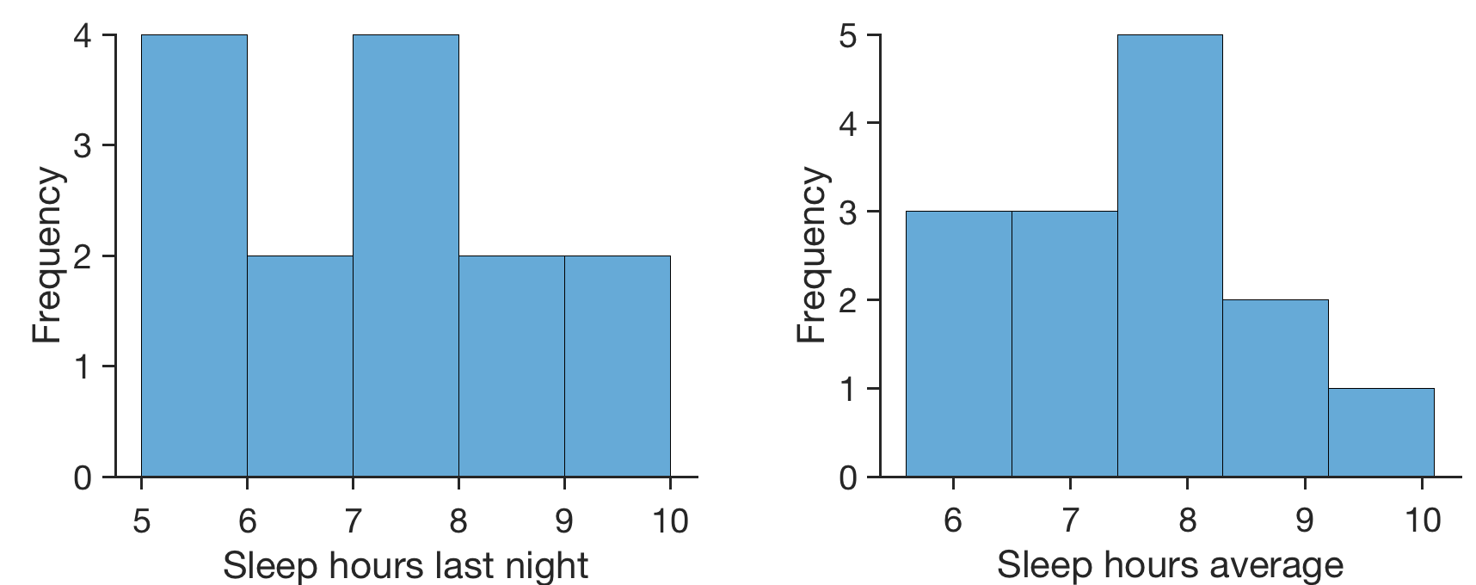
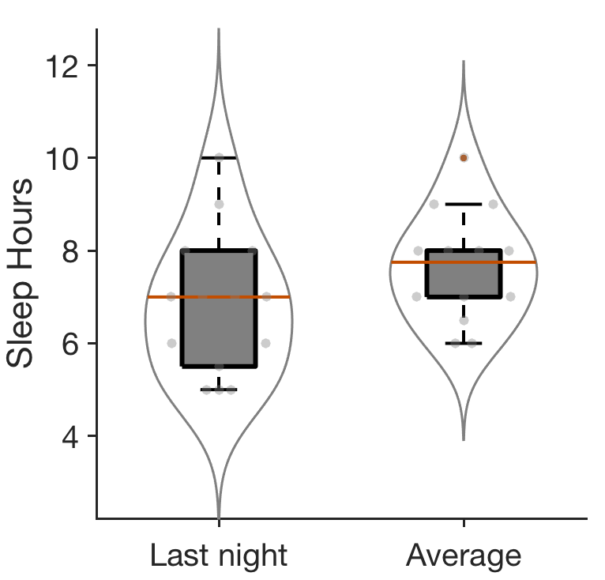
Lecture 02
Distribution
In statistics, variables typically have distributions.
The distribution of a variable tells us what values it takes and how often it takes these values.
 | sleep_hours_last_night | sleep_hours_average
Indiv 1 | 7 | 6
Indiv 2 | 5.5 | 6.5
Indiv 3 | 9 | 7
Indiv 4 | 5 | 7
Indiv 5 | 5 | 6
Indiv 6 | 7 | 8
Indiv 7 | 8 | 7
Indiv 8 | 7 | 8
Indiv 9 | 8 | 10
Indiv 10 | 10 | 9
Indiv 11 | 6 | 7.5
Indiv 12 | 7 | 9
Indiv 13 | 6 | 8
Indiv 14 | 5 | 8
CHOONG-WAN WOO | COCOAN lab | http://cocoanlab.github.io

Slide 17
Lecture 02
Key Points
Chapter 1
What is statistics?
Chapter 2
Who, what, how, where, when, why
Data layout: Cases and variables
Categorical and Quantitative variables
Identifier, ordinal variables
CHOONG-WAN WOO | COCOAN lab | http://cocoanlab.github.io

